Slide 1
BALANCE OF PAYMENTS

Slide 2
BALANCE OF PAYMENTS
BOP or Balance of International Payments is the systematic and summary record of a country’s economic and financial transactions with the rest of the world over a period of time.

Slide 3
As per IMF:
BOP is a statistical statement for a given period showing:
transactions in goods & services and income between an economy and the rest of the world;
changes of ownership and other changes in that country’s monetary gold, SDRs, and claims on and liabilities to the rest of the world; and
unrequited transfers and counterpart entries that are needed to balance, in the accounting sense any entries for the foregoing transactions and changes which are not mutually offsetting. – IMF, Balance of Payments Manual.

Slide 4
DIFFERENCE BETWEEN BOP AND BOT
  Balance of Trade:
only exports and imports of merchandise or goods , i.e. only visible.
Hence does not show the services (shipping, insurance, payment of interest, royalties, tourist spending, etc.)
  BOP:
both visible and invisibles.

Slide 5
NATURE OF BOP ACCOUNTING
Follows double entry book keeping system.
Each transaction has a debit and credit
Has to balance (if not : errors & omissions entry)

Slide 6
COMPONENTS OF BOP
Various entries grouped under 4 categories or accounts (parts)
A) Current Account
B) Capital Account
C) Unilateral Payments Account
D) Official Settlements Account.

Slide 7
COMPONENTS OF BOP
Balance of payment (BoP) comprises:
current account,
capital account,
errors and omissions and
changes in foreign exchange reserves.

Slide 8
CURRENT ACCOUNT
Is a summary record of a nation’s goods and invisibles transactions with the rest of the world.
All transactions which give rise to or use up National Income.
Includes 2 major items:
Merchandise exports & imports
Invisible exports & imports
Exports = credit entry ( i.e. claims on foreigners)
Imports = debit entry (i.e. claims on home country)

Slide 9
INVISIBLES
Invisibles include:
  non factor services:
–travel, transportation, insurance, Government not included elsewhere (GNIE) and miscellaneous, (which includes communication, construction, financial, software, news agency, royalties, management and business services)
  Income
  private transfers ( NRI remittances, gifts ) and official transfers (Grants) ( for which no quid pro quo)
Non Factor Services include:
  export of software services
  travel and transportation (tourist spending,
shipping etc,)

Slide 10
CURRENT ACCOUNT BALANCE
Current account balance is synonymous with net foreign investment.
A current account surplus means that:
  The country has positive net foreign investment (i.e., the country is acting as a net lender to or investor in the rest of the world).
  The country is producing more ( and has more income from this production) than it is spending on goods and services.
  such a country is saving more than it is investing domestically
  A deficit = the nation is a net borrower or domestic savings are less than domestic investment.

Slide 11
CAPITAL ACCOUNT
Shows the capital inflows and outflows.
=Claims and liabilities which go to finance the deficit on current a/c or absorb its surplus.
    Short Term
    Long Term
Capital Outflow = Debit ( eg. Indian inv in a foreign country, inv in foreign securities, govt.loans to foreign countries)
Capital Inflow = Credit ( FDI by a foreign co. in India, loans to Govt. from foreign countries, NRI deposits).
while the loan and FDI are capital account transactions.

Slide 12
CAPITAL ACCOUNT COMPONENTS
Capital inflows can be classified by instrument (debt or equity) and maturity (short or long term).
The main components of capital account include foreign investment, loans and banking capital.
Foreign investment comprising foreign direct investment (FDI) and portfolio investment represents non-debt liabilities, while loans (external assistance, external commercial borrowings and trade credit) and banking capital including non-resident Indian (NRI) deposits are debt liabilities.

Slide 13
UNILATERAL TRANSFER ACCOUNT
= Gifts.
One-sided transactions
Include private remittances, govt grants, pension payments, disaster relief, etc.
If received = credit; if paid = debit
Now included in Other Receipts.

Slide 14
OFFICIAL SETTLEMENT ACCOUNT
=Monetary Movement
Official reserves represent the holdings by the Government (or official agencies) of the means of payment that are generally accepted for the settlement of international claims.

Slide 15
CAUSES OF BOP DISEQUILIBRIUM
Disequilibrium = there is surplus or deficit in BOP
Deficit = demand for forex exceeds the supply
Reasons:
  Economic factors
  Political factors
  Sociological factors

Slide 16
ECONOMIC FACTORS
Development Disequilibrium:
Large scale development expenditure = increase in purchasing power + increase in demand & prices.
--Leads to huge imports (also of Capital Goods)
--Hence adverse BOT →adverse BOP.

Slide 17
2. CAPITAL DISEQUILIBRIUM
Due to cyclical fluctuations in general business activity.
If domestic economy experiences a boom, while the rest of the world not so
--then more purchasing power & demand and higher prices
--hence more imports
But exports difficult because of slackness in world economy.
Hence……

Slide 18
3. SECULAR DISEQUILIBRIUM
If long term BOP problem, then it is due to some secular trends in the economy.
If domestically: persistent high demand and high domestic prices (eg.USA) then imports will always be more than exports.
( if high production costs locally: but high disposable incomes and hence very high aggregate demand and high prices….)

Slide 19
4.STRUCTURAL DISEQUILIBRIUM
Affects exports & imports
Because of development of alternative sources of supply,
discovery of better substitutes,
exhaustion of productive resources,
changes in transport routes and costs etc.

Slide 20
II. POLITICAL FACTORS
Continuous political instability, wars, etc., will lead to capital outflows and inadequacy of domestic investment and production
Hence BOP problems.

Slide 21
III. SOCIAL FACTORS
Changes in tastes, preferences, fashions etc., will affect the exports and imports.
Hence BOP…

Slide 22
CORRECTION OF DISEQUILIBRIUM
Automatic Correction & Deliberate Measures
Automatic: If adverse BOP →fall in the external value of the domestic currency
--So, exports will become cheaper and imports will become costlier
--this will restore …

Slide 23
DELIBERATE MEASURES
Monetary Measures:
Contraction in money supply —will reduce purchasing power→reduce demand
-- so less imports
fall in prices→ cheaper—so more exports

Slide 24
DEVALUATION
Exports cheaper and imports costlier
E.g.: 1966 June: 4.76 to 7.50

Slide 25
EXCHANGE CONTROL
To conserve forex
Only through ADs
Central Bank

Slide 26
TRADE MEASURES
Export incentives
High import duties and restrictions
Canalisation

Slide 27
OTHER MEASURES
Getting foreign loans
Foreign assistance, Aid…
Development of tourism
Export of services, BPOs, ITES, etc.

Slide 28
CAUSES OF BOP PROBLEM IN INDIA
1. Large trade deficit
2. Fall in invisible surplus, caused by
a) increase in invisibles payments (debt service)
b) slackening of emigrants’ remittances and travel income.
3. Sensitive behaviour of foreign creditors and NRIs
4. Declining role of concessional external finance.

Slide 29
INTERNATIONAL TRADE

Slide 30
TRADE PATTERNS AND TRENDS
Imports are the goods and services that we buy from people in other countries.
Exports are the goods and services that we sell to people in other countries. We trade internationally:
  Goods
  Services

Slide 31
TRADE PATTERNS AND TRENDS
Trading Blocs A trading bloc is a group of nations in an international organization.
The three largest geographical trading blocs are:
  North American Free Trade Agreement
  Asia-Pacific Economic Cooperation
  European Union

Slide 32
NORTH AMERICAN FREE TRADE AGREEMENT (NAFTA)
An agreement between the United States, Canada, and Mexico to make trade among them easier and freer.
NAFTA came into effect in 1994 and since then trade among these three countries has grown rapidly.
All American countries, except Cuba, have entered into a Free Trade of the Americas process, which aims for free trade among all American nations by 2005.

Slide 33
ASIA-PACIFIC ECONOMIC COOPERATION (APEC)
APEC is a group of 21 nations that border the Pacific Ocean.
APEC was established in 1989 and has developed into an organization that promotes freer trade and cooperation among its members.
In 1999, APEC nations conducted 44 percent of world international trade.

Slide 34
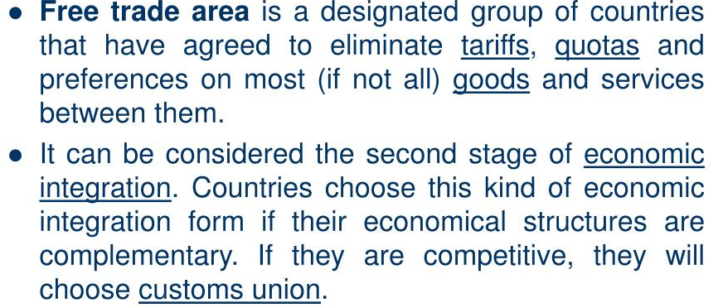
FTA’S

Slide 35
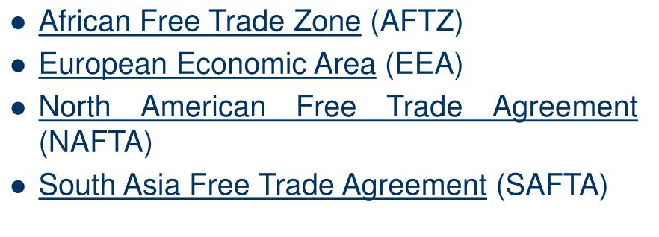
FREE TRADE AREAS

Slide 36
IMF

Slide 37
ABOUT IMF
The International Monetary Fund (IMF) is an organization established 1945
Membership: 189 countries
Headquarters: Washington, D.C.
Executive Board: 24 Directors each representing a single country or a group of countries
Staff: Approximately 2,700 from 148 countries
Total quotas: US$668 billion

Slide 38
FUNCTION
Exchange Stability
Eliminating BOP Disequilibrium
Determination of Par Value
Stabilize Economies
Credit Facilities
Maintaining Balance Between Demand and Supply of Currencies

Slide 39
BENEFITS
  Foster global monetary cooperation
  Secure financial stability
  Facilitate international trade
  Promote high employment
  Sustainable economic growth
  Reduce poverty around the world.
  International monetary co operation
  Exchange stability
  Checking competitive depreciation
  Increased assistance
  Increase in capital resources
  Expansion of trade
  AID to members during emergency

Slide 40
ADVANTAGES FOR INDIA
Facility of foreign exchange.
Freedom from British pound Sterling.
Membership of the World Bank.
Importance of India in international sector.
Economic consultation.
Financial Assistance from the fund

Slide 41
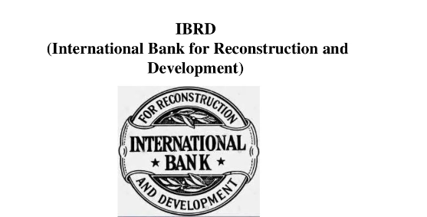

Slide 42
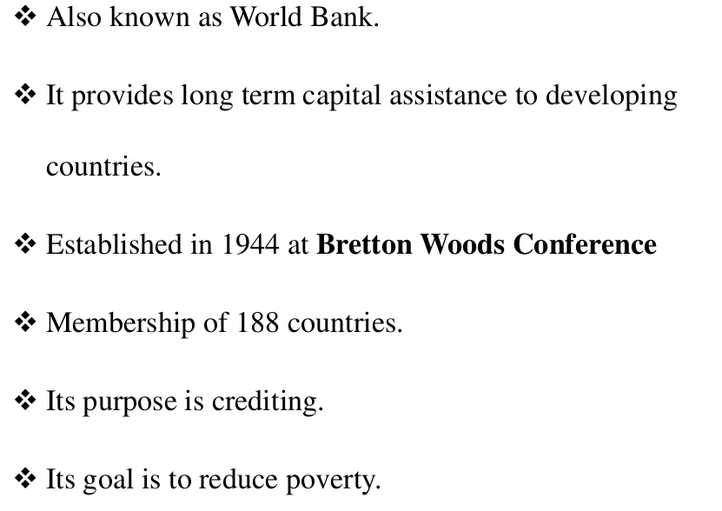

Slide 43
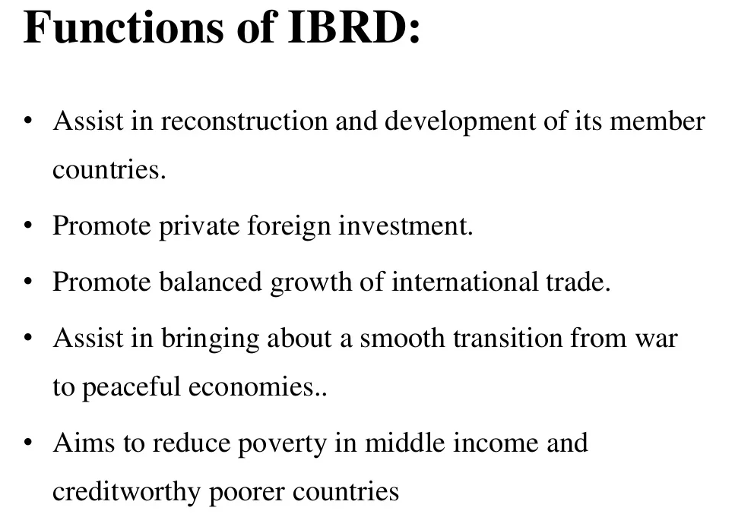

Slide 44
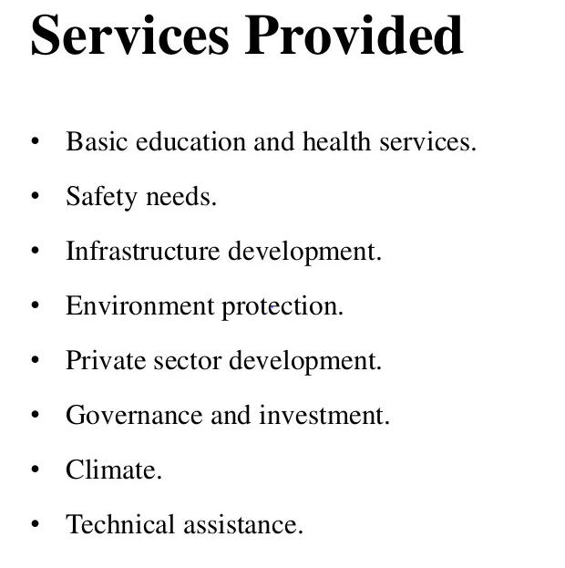

Slide 45
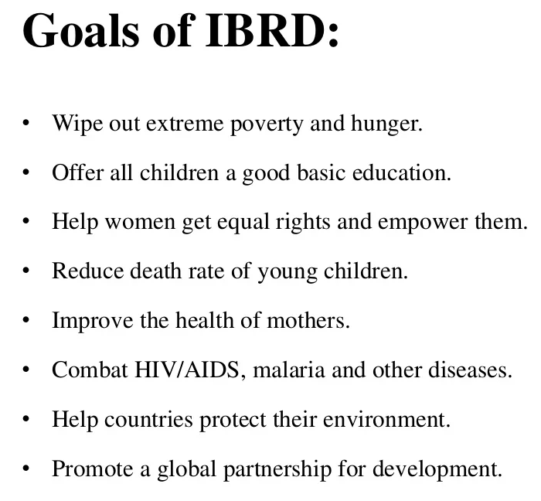

Slide 46
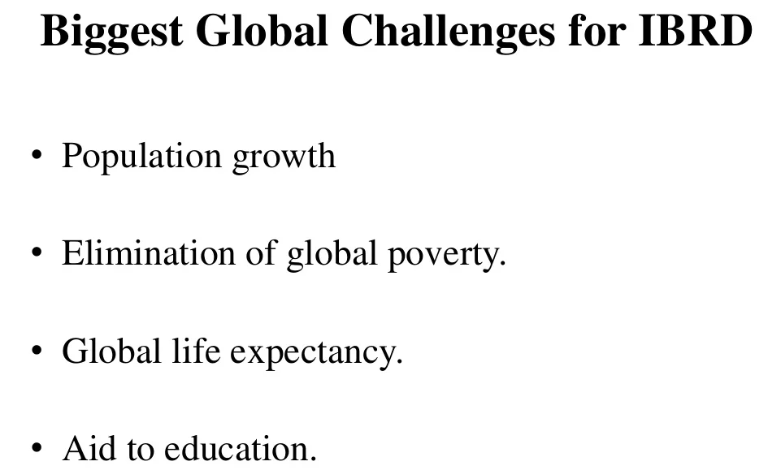

Slide 47
WTO
WORLD TRADE ORGANIZATION

Slide 48
INTRODUCTION
Headquarters: Centre William Rappard, Geneva, Switzerland.
Establish: 1 January 1995
Created by :Uruguay round negotiation (1986-94)
Membership: 159 countries on 2 March 2013
Budget: 197 million swiss francs for 2013
Secretariat staff: 640
Director-General: : Roberto Azevêdo

Slide 49
INTRODUCTION
The World Trade Organization (WTO) is the international body dealing with the rules of trade between nations.
Its goal is to supervise and expand international trade, monitor national trade policies, and provide technical assistance to developing nations.

Slide 50
INTRODUCTION
The WTO is a forum for negotiating and formalizing agreements between nations, as well as resolving disputes.
The organization grew from the General Agreement on Tariffs and Trade (GATT), which was established shortly after World War II.

Slide 51
OBJECTIVES OF WTO
to implement the new world trade system as visualized in the Agreement;
to promote World Trade in a manner that benefits every country;
to ensure that developing countries secure a better balance in the sharing of the advantages resulting from the expansion of international trade corresponding to their developmental needs;
to demolish all hurdles to an open world trading system and usher in international economic renaissance because the world trade is an effective instrument to foster economic growth;

Slide 52
OBJECTIVES OF WTO
to enhance competitiveness among all trading partners so as to benefit consumers and help in global integration;
to increase the level of production and productivity with a view to ensuring level of employment in the world;
to expand and utilize world resources to the best;
to improve the level of living for the global population and speed up economic development of the member nations.

